Slide 1
BASIC INTUITION OF THE SUPPORT VECTOR ALGORITHM

Slide 2

HELLO!
Ambassador - Open Data Science Conference
Volunteer - Lagos Women in Machine Learning Data Science
You can find me on social Media at:
Twitter: @diyyah92
LinkedIn:www.linkedin.com/in/Aminah-mardiyyah-rufa-i
Medium: @mardiyyah
I am Aminah Mardiyyah Rufai!
Notes:
I studied Chemical Engineering at the undergraduate level and recently Obtained a Master’s degree in Biomedical Engineering. I began my Data science Journey in 2018 and have worked on a couple of Projects since then. Including the Fruit scanner device at a Hackathon and several other projects. You can find me on social media with ID as shown on the slide.

Slide 3
SLIDE CONTENTS
The Support Vector Machine as a Machine learning algorithm.
Basic Concepts and Intuition of the Support Vector Machine.(Key Points to note and Some basic terminologies
Use Case: Breast Cancer Classification

Slide 4
THE SUPPORT VECTOR MACHINE AS A MACHINE LEARNING ALGORITHM

Slide 5
THE SUPPORT VECTOR MACHINE AS A MACHINE LEARNING ALGORITHM
The Support Vector Machine is one of the “Dual purposes Supervised Machine Learning Algorithms”,i.e it serves as both a Regression(Support Vector Regressor) and a Classification Algorithm(Support Vector Classifier).
This unique algorithm was first introduced in the 1960s and later improved on in the 1990s by Vapnik et al. It was the first algorithm at that time to beat the Neural Network in the hand digits classification. It hence gained popularity and has been used for several other use cases
Notes:
Dual purpose because it applies both as a regressor and as a classifier. So this Algorithm is quite unique because it uses a technique, different from all other machine learning algorithms for classification.

Slide 6
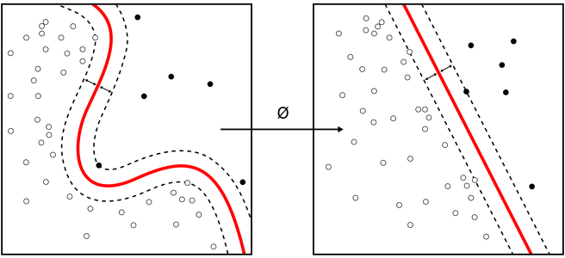
Why is it Unique?
The Support Vector Machine(SVM) as a classifier can conveniently perform tasks for both linearly separable and non-linearly separable data points, using its superpower(the kernel trick).
Notes:
Unlike other classification algorithm which works best for class of data points , either linearly separable data points or non linearly separable. Like the Logistic regression for example, which works best for linearly separable data points as it can easily draw a decision boundary. SVM can comfortably work with both type of data points using its unique trait, its superpower- ‘The Kernel Trick’. Take a look at the image on the right, the ist image shows a non-linearly separable data points, while the second image shows a linearly separable data . Notice how the algorithm is able to adjust and comfortably still draw a decision boundary to separate the points

Slide 7
Basic Concepts and Intuition of the Support Vector Machine

Slide 8
SOME KEY POINTS ON SVM
It is also known as a ‘Support Vector Network’.
It is a Discriminative Machine Learning Classification Algorithm.
It classifies data points into two classes at a time(, using a decision boundary(a hyperplane in this case).
The primary objective of the Support vector Classifier is finding the ‘Optimal Separating Hyperplane(Decision Boundary)’.
Notes:
Point 1: It is a network because as an algorithm, it finds applications in several areas such as Regression classification and Clustering problems. It is also used in image classification, using the sigmoid kernel function.
Point 2: It is different from algorithms like naive bayes, which is a generative algorithm. Point 3: this does not mean it is only a binary classifier, it only separates data points into two classes at a time)
Point 4:

Slide 9
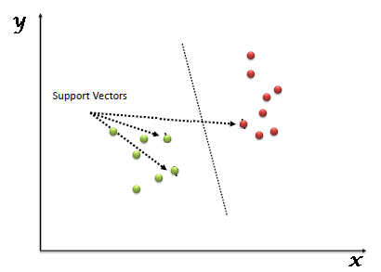
SOME BASIC TERMINOLOGIES
Vector: This is simply the training examples/data points. It is also known as ‘Feature vectors’ in machine learning.
Support + Vector: This is simply a subset of the data closest to the hyperplane/decision boundary.
Notes:
So ‘Support Vector + Machine’ What does it really mean? Let’s break down the basic terminologies. They are called support vectors because they play a major role in determining where and how the margin for the hyperplane is drawn, also how the maximum margin hyperplane is chosen.

Slide 10
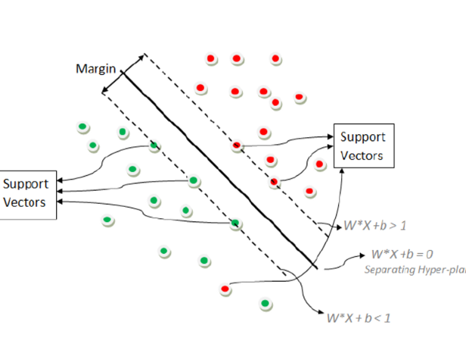
SOME BASIC TERMINOLOGIES
Margin: This is the distance between the decision boundary at both sides and the nearest/closest support vectors. It can also be defined as the shortest distance between the hyperplane and the support vectors with weight w, and bias b.
Notes:
It is simply the shortest distance between support vectors and the decision boundary at both ends

Slide 11
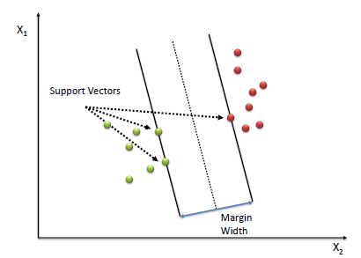
Support Vectors + Margin
Notes:
So taking a look at the image here, the hyperplane/decision boundary is the middle line here. While the margin is the two parallel lines drawn with equal distances away from the hyperplane. Notice the label of the support vectors, these are the vectors that determine the margin width and the position of the hyperplane. Hence the name ‘Support Vectors’.So These vectors are intuitively called ‘Support vectors’ because they support the hyperplane/decision boundary and act as a pillar.

Slide 12
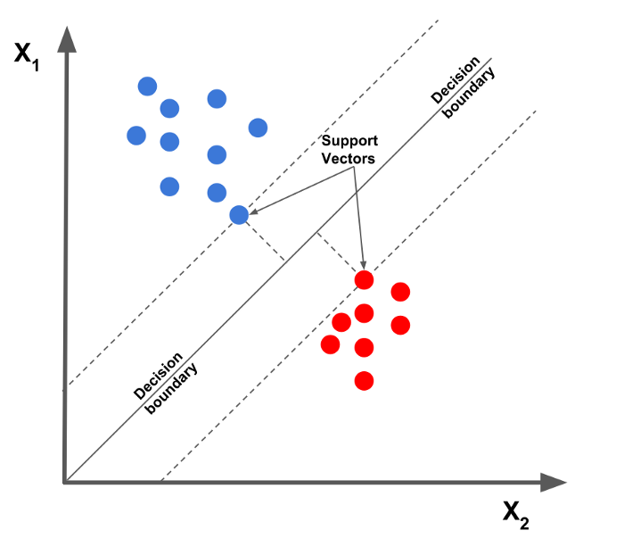
SOME BASIC TERMINOLOGIES
Hyperplane: In machine learning terms, it is a form of a decision boundary that algorithms like the Support Vector Machine uses to classify or separate data points
Notes:
In geometry, it is an n-dimensional generalization of a plane, a subspace with one less dimension(n-1) than its origin space. In one-dimensional space, it is a point, In two-dimensional space it is a line, In three-dimensional space, it is an ordinary plane, in four or more dimensional spaces, it is then called a ‘Hyperplane’. Take note of this, it is really how the Support Vector Machine works behind the scenes, the dimensions are the features represented in the data. For example, say we want to carry out a classification problem and we want to be able to tell if a product gets purchased or not(a binary classification), if there is just one feature(say Gender) available as a feature in the dataset, then it is in one-dimensional space and the subspace(the separating/decision boundary) representation will be (n-1=0) a 0-dimensional space(if I can call it that), represented with just a point showing the separation of classes(Purchased or not). If there are two features(Age and Gender), it is a two-dimensional space(2D), with either of Age and Gender on the X and y-axis, the decision boundary will be represented as a simple line. Similarly, if the features are three(Age, Gender, Income), the decision boundary will be a two-dimensional plane in a three-dimensional space(n-1). Furthermore, if we have a four or more dimensional space data points, then it is called a ‘Hyperplane’ with (n-1 dimension). It is important to note that the number of features for a given machine learning problem can be selected using a technique called ‘feature selection’, as not all features are necessarily useful, some can be redundant and create unnecessary noise in the data.

Slide 13
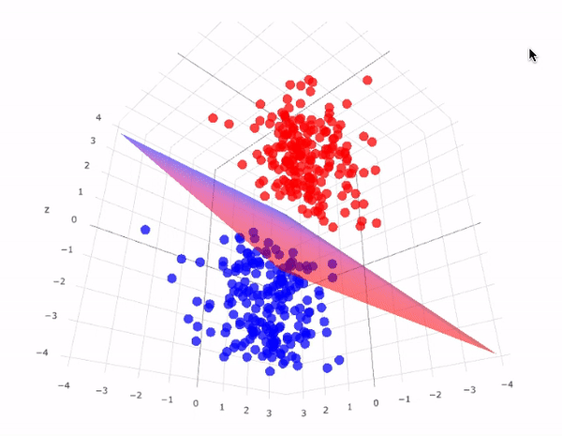
THE HYPERPLANE IN SPACE
Notes:
This is how the hyperplane somewhat looks like in an n-dimensional space, it is really more like a separating boundary that splits a space into equal halves. So in ML, it is more like an intuitive split into various classes.

Slide 14
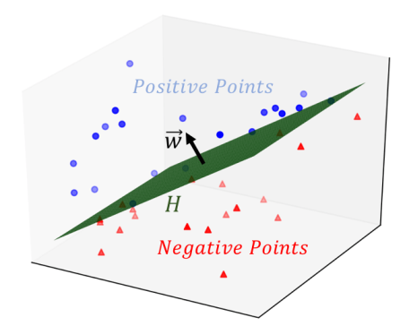
THE HYPERPLANE IN SPACE
Notes:
So technically, there are two parts to the hyperplane(in whatever dimension it has been represented). The positive and negative side

Slide 15
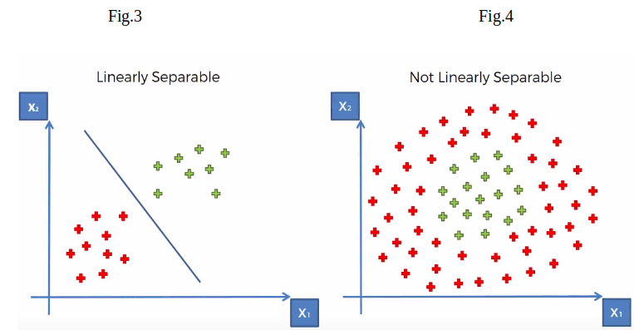
SOME BASIC TERMINOLOGIES
Linearly Separable Data points: Data points can be said to be linearly separable if a separating boundary/hyperplane can easily be drawn showing distinctively the different class groups.
Non-Linearly Separable Data Points: This is the exact opposite of Linearly separable data points.
Notes:
Linear separable data points mostly require linear machine learning classifiers such as Logistic regression for example.
Non-Linear data: Take a look at the second image on the right, notice that no matter how one tries to draw a straight line, some data points will one way or the other get misclassified. SVM has a special way of classifying this type of data. It uses Kernel functions to represent these data points in a higher-dimensional space and then finds the optimal separating hyperplane.

Slide 16
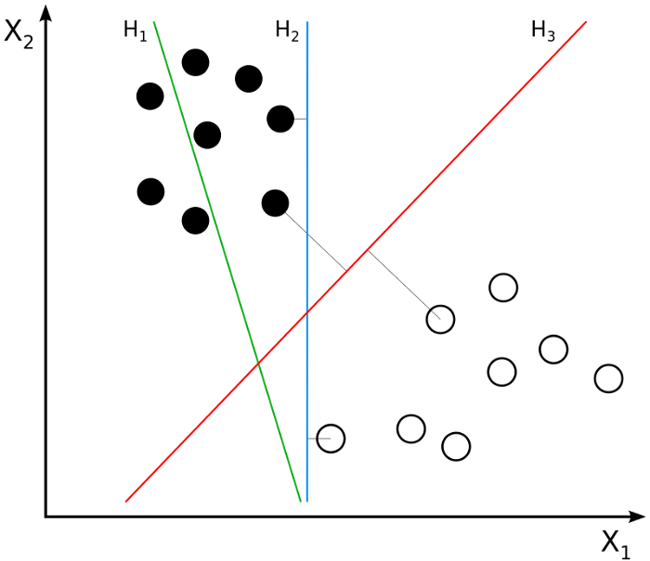
SOME BASIC TERMINOLOGIES
Maximum Margin Hyperplane: The Maximum Margin hyperplane is a hyperplane drawn such that it gives the ‘largest Margin’, which is used for classification
.
Notes:
Ok! So i don’t want to bore you with too many terminologies, i will explain just two more very important terms and then we move into a use case and see how this works real time with code. So As mentioned earlier, the primary objective of the Support vector Classifier is to find the optimal separating hyperplane, where data points are efficiently classified with fewer errors as possible. It is the simplest way to classify data if they are linear. The chosen hyperplane has the largest separating distance on both sides of the support vectors. Take a look at the image below, there are three separating hyperplanes drawn, while one does not accurately separate the data points(h1), the other two(h2 and h3) do. However, the maximum margin hyperplane in this example is h3.

Slide 17
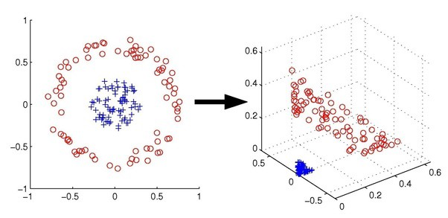
THE KERNEL TRICK
Kernels or Kernel Functions are methods with which linear classifiers such as SVM use to classify non-linearly separable data points. This is done by representing the data points in a higher-dimensional space than its original
.
Notes:
For example, a 1D data can be represented as a 2D data in space, a 2D data can be represented as a 3D data et cetera. So why is it called a ‘kernel trick’? SVM cleverly re-represents non-linear data points using any of the kernel functions in a way that it seems the data have been transformed, then finds the optimal separating hyperplane. However, in reality, the data points still remain the same, they have not actually been transformed. This is why it is called a ‘kernel Trick’.

Slide 18

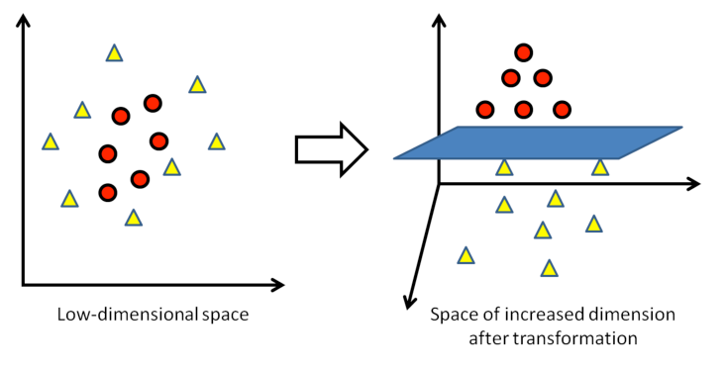
THE KERNEL TRICK
Notes:
What happens here is the data was re-represented in a higher dimensional space, from 2D to 3D and this made it easier to efficiently and effectively separate the points. The kernel trick offers a way to calculate relationships between data points using kernel functions, and represent the data in a more efficient way with less computation. Models that use this technique are called ‘kernelized models

Slide 19
KERNEL FUNCTIONS USED
Polynomial Kernel Function
The Radial Basis Function (RBF)
The Sigmoid Function
The Linear Function
Notes:
The Polynomial function:transforms data points by using the dot product and transforming data to an ‘n-dimension’, n could be any value from 2, 3 et cetera, i.e the transformation will be either a squared product or higher. Therefore representing data in higher-dimensional space using the new transformed points. RBF: This function behaves like a ‘weighted nearest neighbor model’. It transforms data by representing in infinite dimensions, then using the weighted nearest neighbor (observation with the most influence on the new data point) for classification. The Radial function can be either Gaussian or Laplace. This is dependent on a hyperparameter known as gamma. It is the most commonly used kernel. The SIgmoid function: also known as the hyperbolic tangent function(Tanh), finds more application in neural networks as an activation function. This function is used in image classification.

Slide 20
USE CASE: BREAST CANCER CLASSIFICATION

Slide 21
REQUIRED STEPS
Get the data
Import the Libraries
Import the dataset
Train the algorithm
Test the model
Evaluate the model
Visualize results
Hyperparameter tuning (what parameters to look at)
Re-evaluation

Slide 22
GET THE DATA
The breast cancer dataset can be downloaded from the UCI Machine Learning repository
We will be using the ‘Breast Cancer Wisconsin(Original) dataset’.
Link for data:
“https://archive.ics.uci.edu/ml/datasets/Breast+Cancer+Wisconsin+%28Original%29”

Slide 23
Required Python Libraries
Pandas — for data analysis/manipulation
Numpy — for Linear Algebra
Matplotlib - for visualization
Seaborn - for Visualization
ScikitLearn(Sklearn) — For modeling and evaluation

Slide 24
LET’S MOVE ON TO THE PRACTICAL SESSION
Notes:
Talk about how to download and import the dataset from UCI and the column headers too

Slide 25

Thank You for Listening!

